Slide 1


Data Science for Predicting
Term Deposit Subscriptions in Banking Marketing
Nunna Pooja
nunna_p@me.iitr.ac.in

Slide 2




Banking Dataset Analysis
The dataset is related to direct marketing campaigns of a Portuguese banking institution.
Objective: Predict whether a client will subscribe to a term deposit.
Includes client demographics, financial data, and campaign details.

Slide 3

Dataset Details
Total Rows: 45,211
Total Columns: 18
Timeframe: May 2008 – November 2010
Key Features: Age, Job, Marital Status, Education, Default, Balance, Housing Loan, Loan, etc.

Slide 4
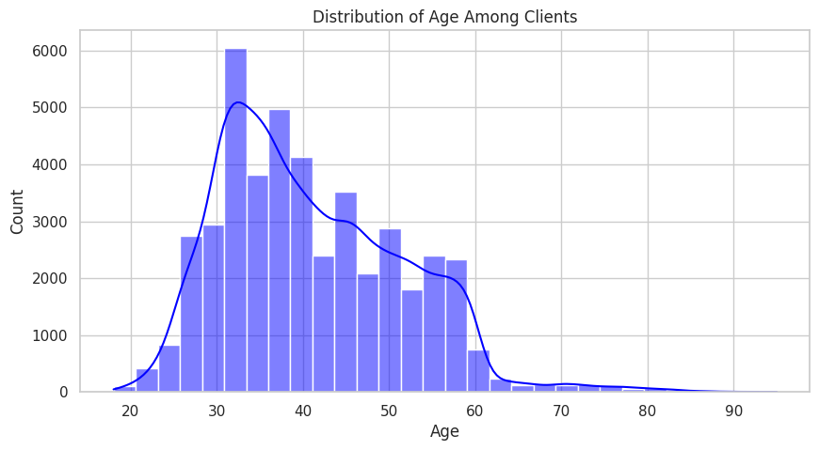
Age Distribution Among Clients
Age ranges from 18 to 95 years.
Most clients fall between 30 and 40 years of age.

Slide 5
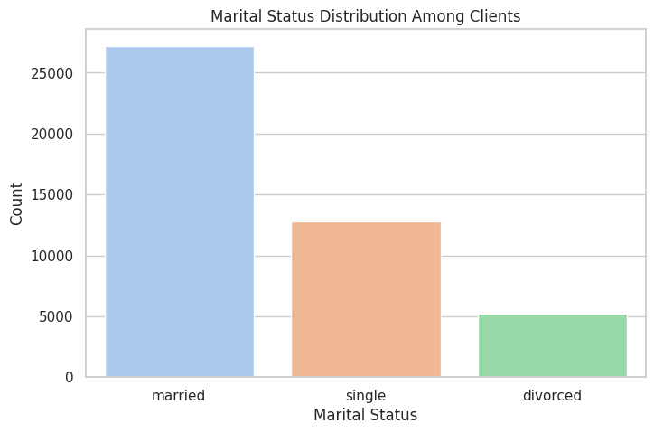
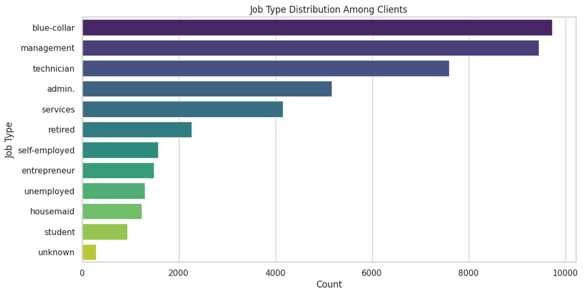
Job Type and Marital Status
Top Job Types: Management, Blue-collar, and Technician.
Marital Status: ~60% Married, ~30% Single, ~10% Divorced.

Slide 6
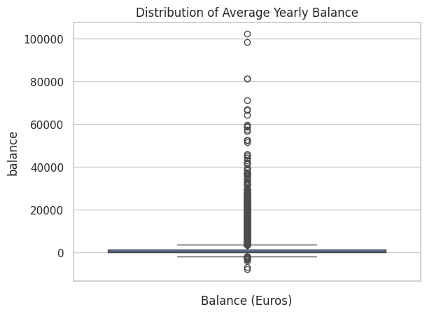
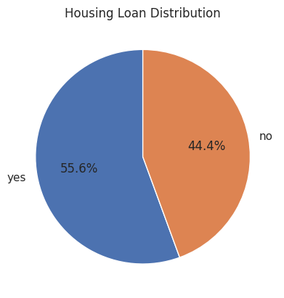
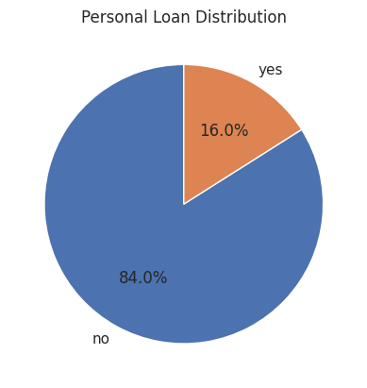
Financial Characteristics
Average Yearly Balance: Range from negative to high positive values.
Clients with Default: ~2% of total clients.
Housing Loans: ~56% have housing loans.
Personal Loans: ~16% have personal loans.

Slide 7
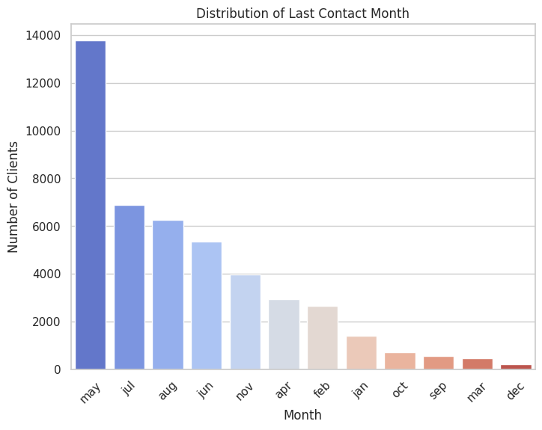
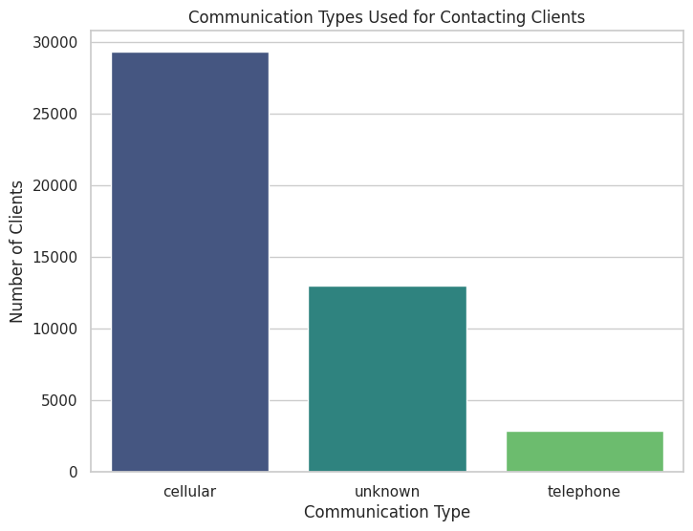
Campaign Characteristics
Communication Types: Cellular (70%), Telephone (20%), Unknown (10%).
Last Contact Month: Most calls in May, July,August
Duration of Last Contact: Median duration ~180 seconds.

Slide 8
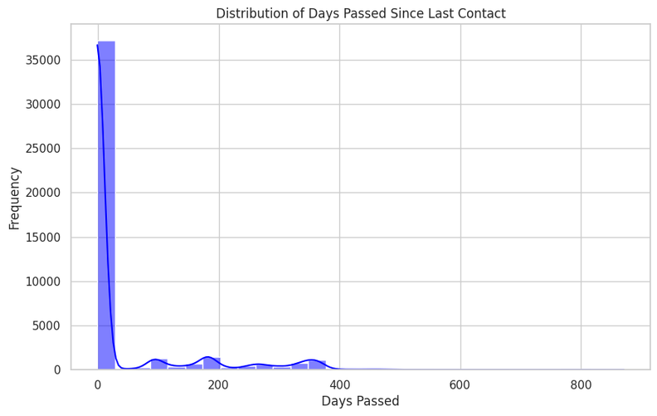
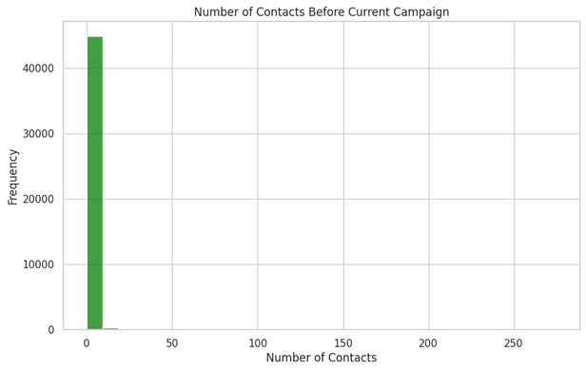

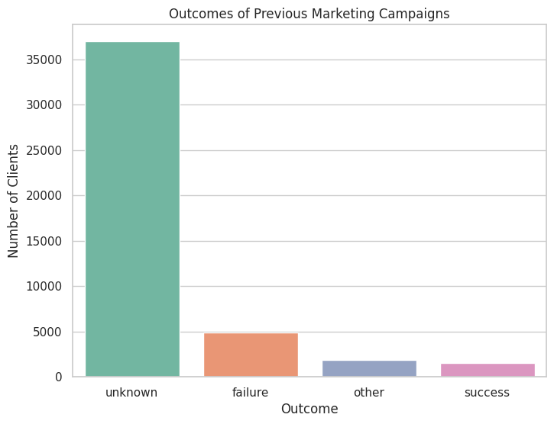
Previous Campaign Metrics
Days Passed Since Last Contact: ~85% had no previous contact (-1 days).
Contacts Before Current Campaign: Majority had 0 or 1 prior contact.
Previous Outcomes: ~65% unknown, ~25% failure, ~10% success.

Slide 9
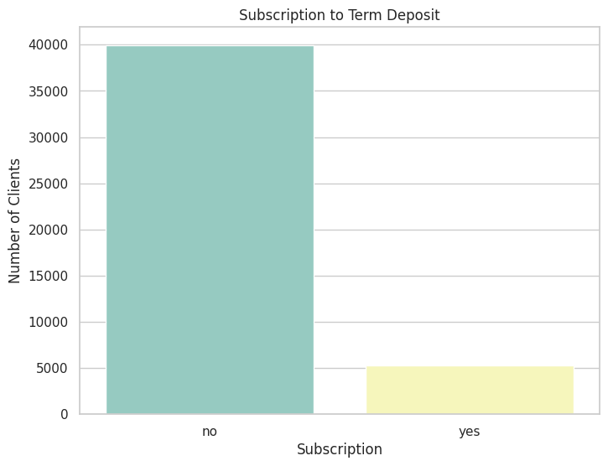
Subscription Insights
Term Deposit Subscription Rate: ~11% subscribed.
Majority of subscriptions came from younger, educated clients with positive balances.

Slide 10
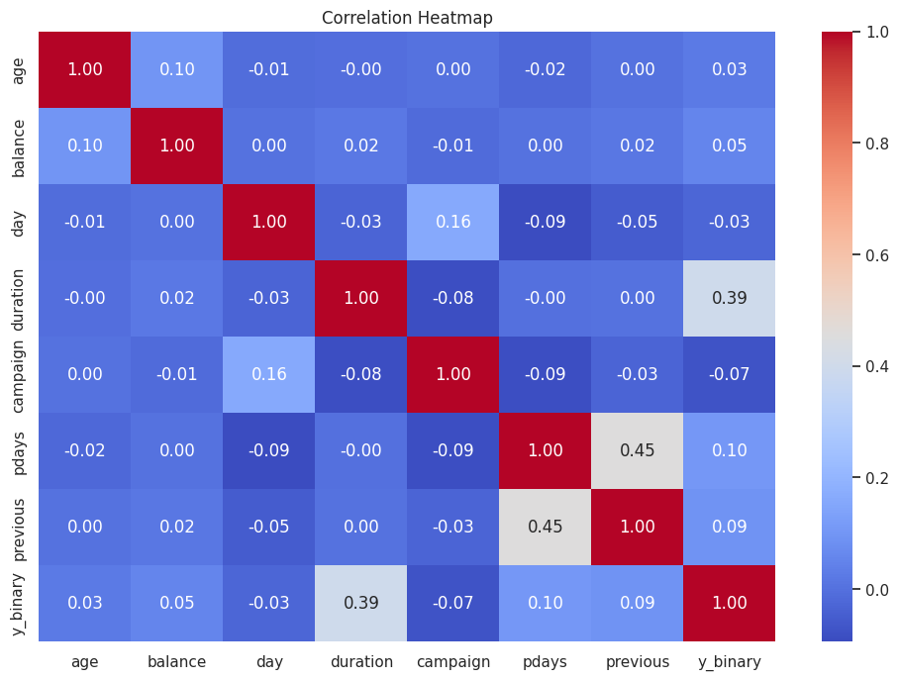
Correlations with Subscription Likelihood
Positive Correlations: Duration, Previous Campaign Success.
Negative Correlations: Number of Contacts, Days Passed.
No Significant Correlation: Age, Balance.

Slide 11

Key Insights and Suggestions
Focus on younger, educated clients with good financial standing.
Prioritize clients with successful previous campaign outcomes.
Optimize campaign duration for better results.
Avoid targeting clients with excessive contacts to reduce costs.
Data-driven insights can enhance the effectiveness of telephonic marketing campaigns, improving client engagement and subscription rates.
Nunna Pooja
-
nunna_p@me.iitr.ac.in

